Slide 1

University Institute of Engineering
DEPARTMENT – AU1- AU5
Bachelor of Engineering
Subject Name: Mathematics-II
Subject Code: 23SMT-125
DISCOVER . LEARN . EMPOWER

Slide 2
COURSE OUTCOMES
CO Number | Title | Level
CO1 | Remember the concepts based upon partial differentiation, multiple integrals and vector calculus. | Remember
CO2 | Understand the concepts of the partial differentiation, multiple integrals and vector calculus. | Understand
CO3 | Apply concepts of partial differentiation, multiple integrals and vector calculus and to use in practical problems. | Apply
Will be covered in this lecture
CO4 | Analyze concepts of partial differentiation, multiple integrals and vector calculus and its application of analysis to Engineering problems. | Analyze
CO5 | Create the solution for real problems based upon partial differentiation, multiple integrals and vector calculus. | Applications

Slide 3
VECTOR CALCULUS
Here, we define two operations that:
Can be performed on vector fields.
Play a basic role in the applications of vector calculus to fluid flow, electricity, and magnetism.
Each operation resembles differentiation.
However, one produces a vector field whereas the other produces a scalar field.

Slide 4
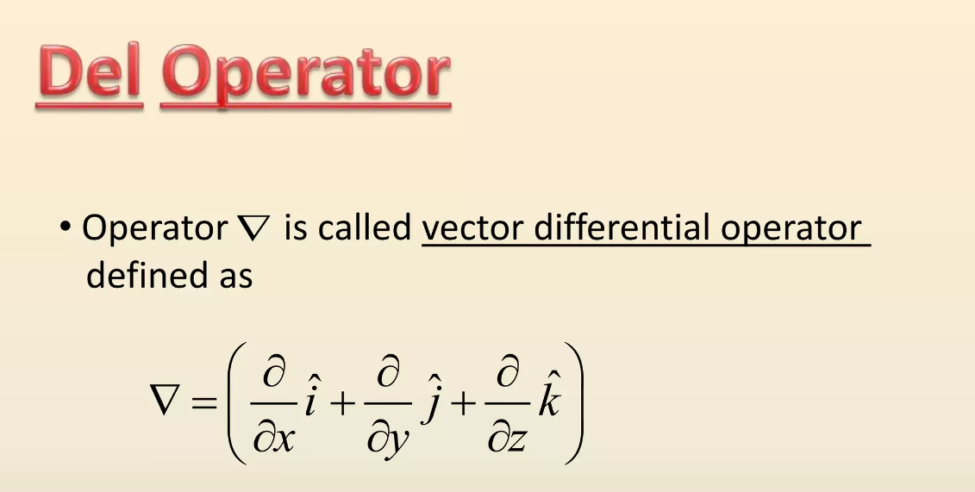

Slide 5
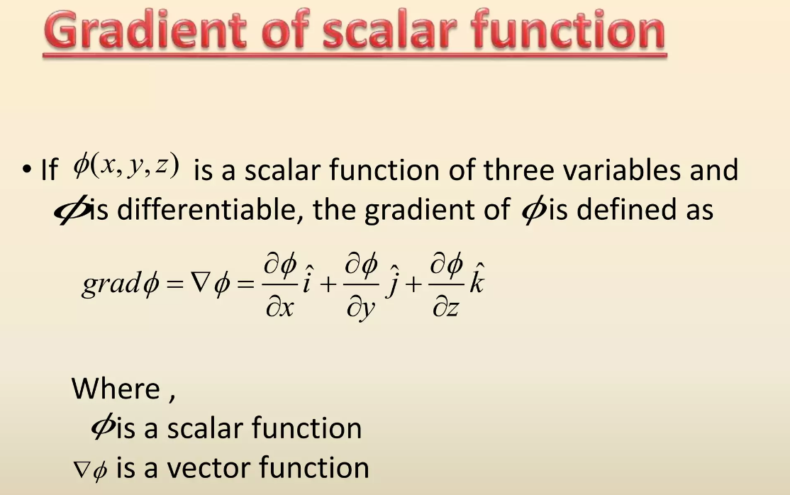

Slide 6
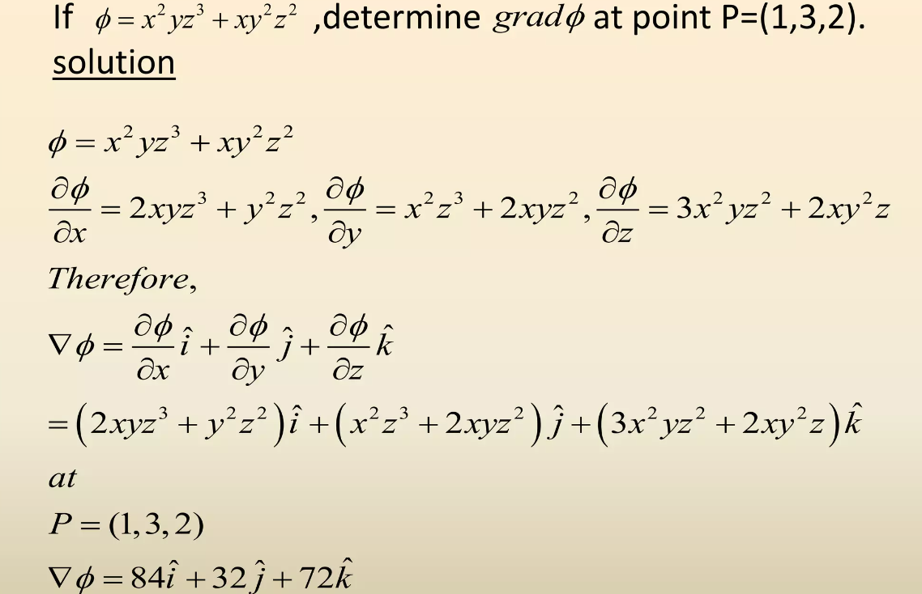

Slide 7
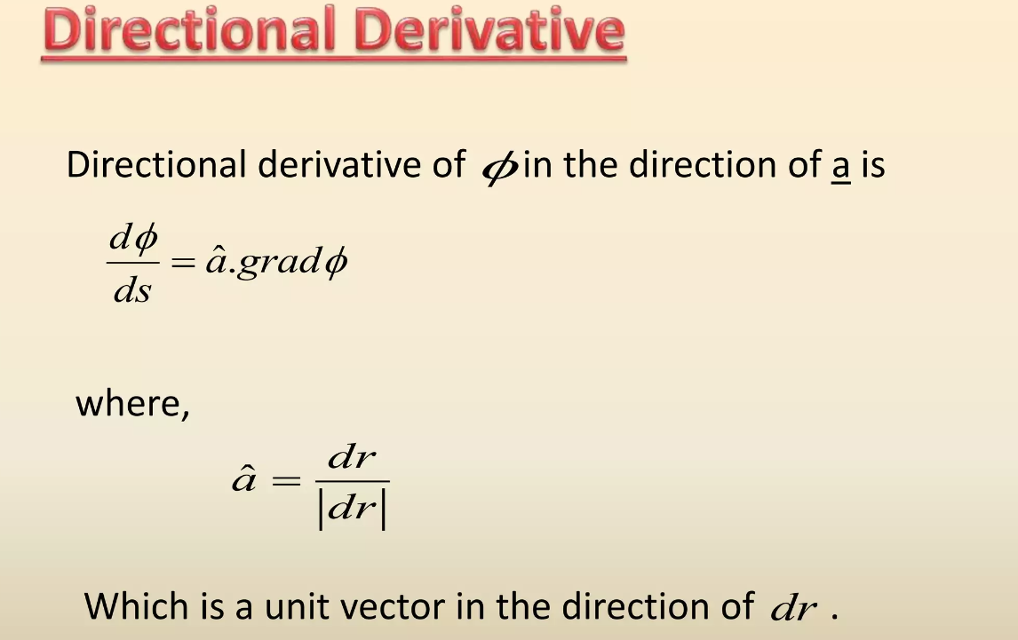

Slide 8
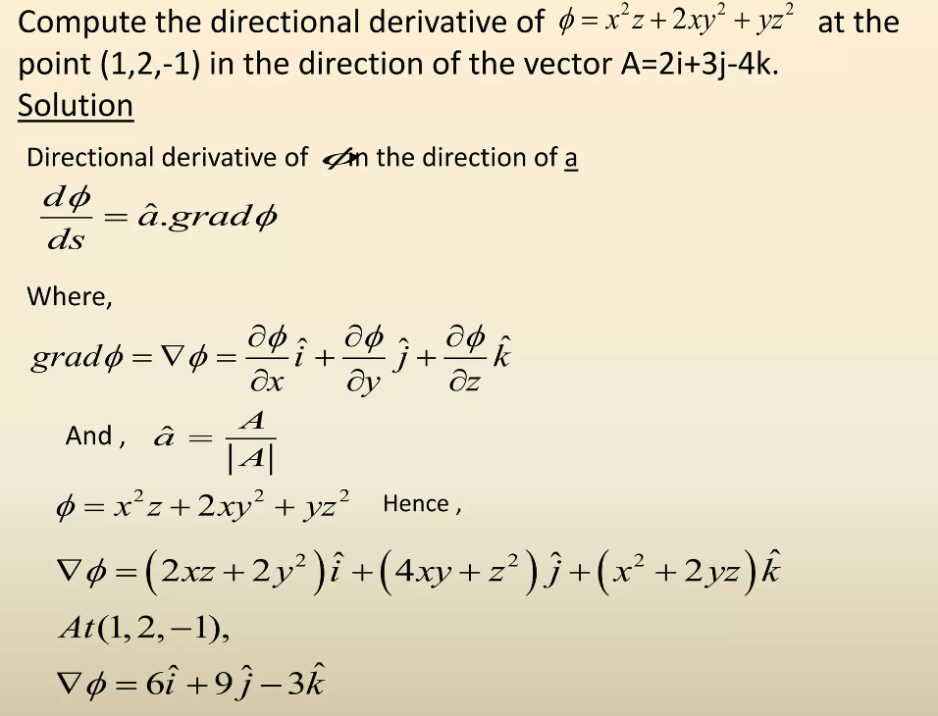

Slide 9
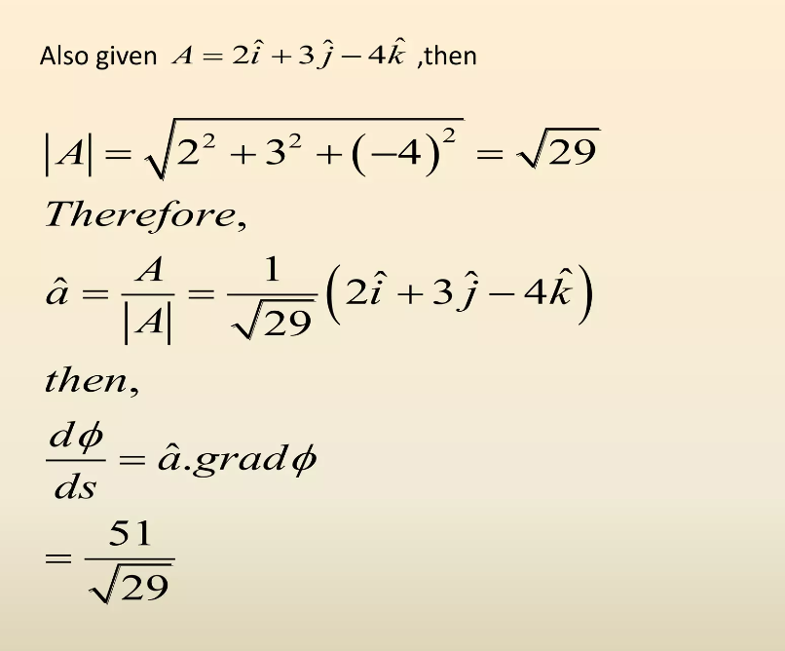

Slide 10
DIVERGENCE
If F = P i + Q j + R k is a vector field on and ∂P/∂x, ∂Q/∂y, and ∂R/∂z exist, the divergence of F is the function of three variables defined by:

Slide 11
DIVERGENCE
In terms of the gradient operator
the divergence of F can be written symbolically as the dot product of and F:

Slide 12
DIVERGENCE
If F(x, y, z) = xz i + xyz j – y² k find div F.
By the definition of divergence (Equation 9 or 10) we have:

Slide 13
DIVERGENCE
Again, the reason for the name divergence can be understood in the context of fluid flow.
If F(x, y, z) is the velocity of a fluid (or gas), div F(x, y, z) represents the net rate of change (with respect to time) of the mass of fluid (or gas) flowing from the point (x, y, z) per unit volume.

Slide 14
GRADIENT VECTOR FIELDS
Another differential operator occurs when we compute the divergence of a gradient vector field .
If f is a function of three variables, we have:

Slide 15
CURL

Slide 16
CURL
Thus, the easiest way to remember Definition 1 is by means of the symbolic expression

Slide 17
CURL

Slide 18
GRADIENT VECTOR FIELDS
By Clairaut’s Theorem,

Slide 19
CONSERVATIVE VECTOR FIELDS
A conservative vector field is one for which
So, Theorem 3 can be rephrased as: If F is conservative, then curl F = 0.
This gives us a way of verifying that a vector field is not conservative.

Slide 20
CONSERVATIVE VECTOR FIELDS
Example
Show that the vector field F(x, y, z) = xz i + xyz j – y² k is not conservative.
In Example 1, we showed that: curl F = –y(2 + x) i + x j + yz k
This shows that curl F ≠ 0.
So, by Theorem 3, F is not conservative.

Slide 21
F = 0 (IRROTATIONAL CURL)
If curl F = 0 at a point P, the fluid is free from rotations at P.
F is called irrotational at P.
That is, there is no whirlpool or eddy at P.

Slide 22
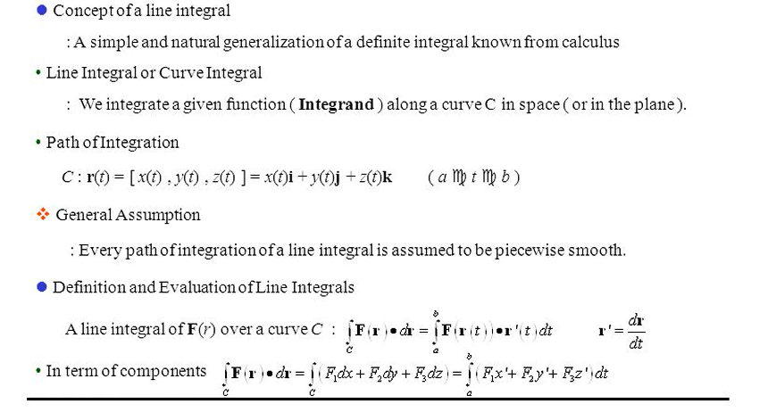
LINE INTEGRAL

Slide 23
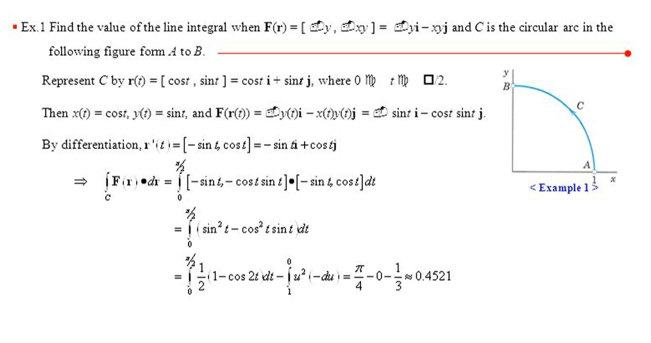

Slide 24
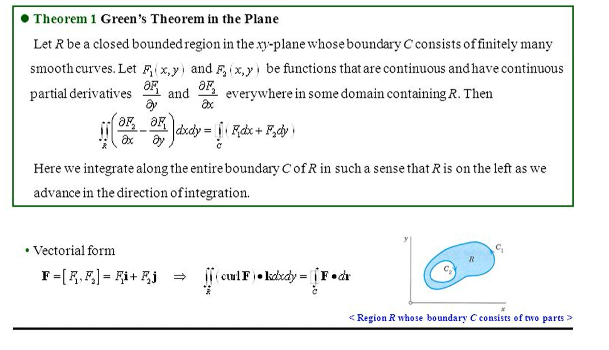

Slide 25
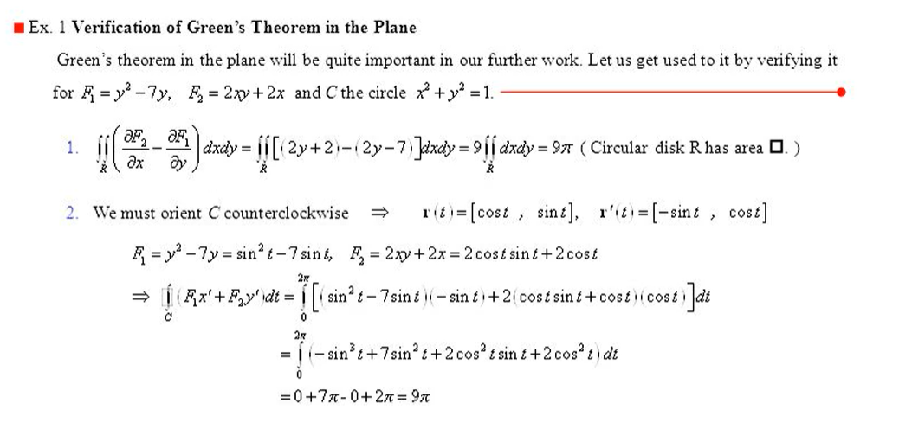

Slide 26
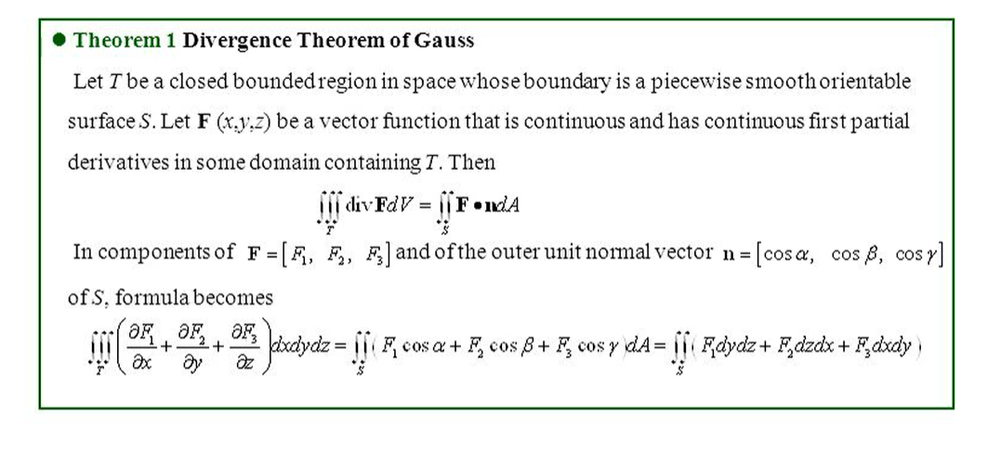

Slide 27
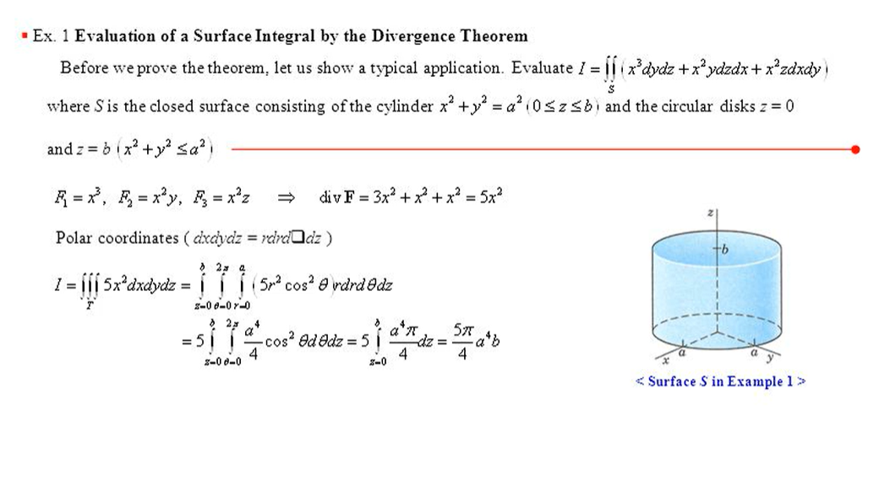

Slide 28
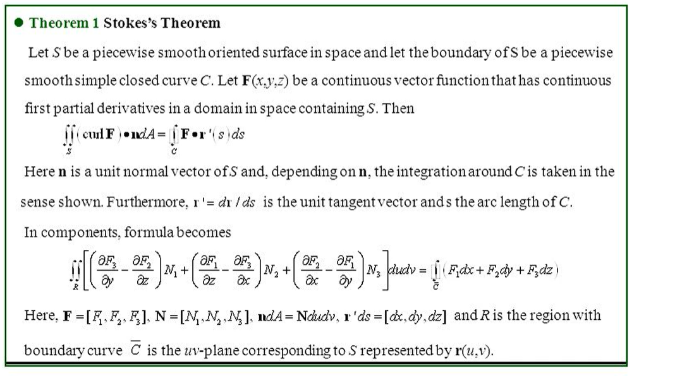

Slide 29
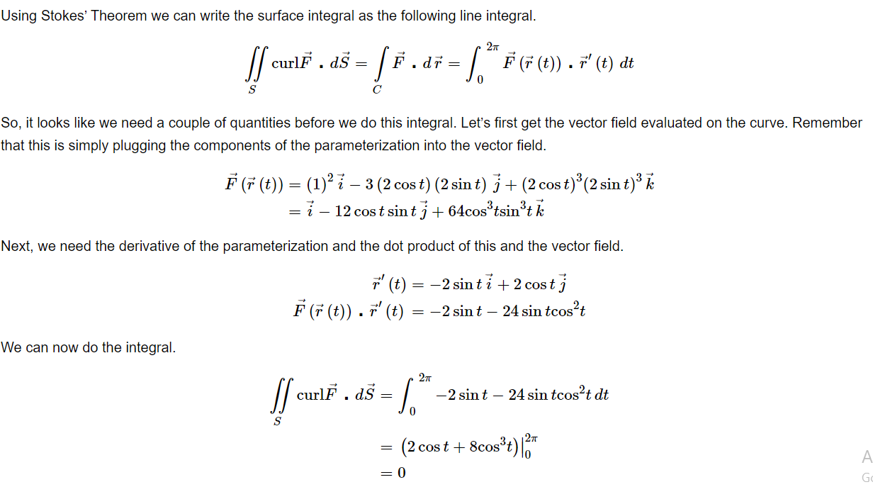

Slide 30
REFERENCES
TEXTBOOKS:
1. E. Kreyszig, Advanced Engineering Mathematics, John Wiley,10th Ed.2011., New Delhi
2. H.K. Dass, Higher Engineering Mathematics, S Chand Publishers, 3rd revised edition, 2014.
3. R.K. Jain, and S.R.K. Iyengar, Advanced Engineering Mathematics, 3rd Edition, Narosa Publishing House, 2004, New Delhi.
Reference Material:
1. B.V. Ramana Advanced Engineering Mathematics, McGraw Hill, July 2006, New Delhi.
2. B. Thomas and, R.L., Finney, Calculus and Analytic Geometry, Pearson Education, 11thEdition.
3. N.P. Bali and Manish Goyal, Atextbook of Engineering Mathematics, Laxmi Publications, Reprint, 2008
Suggestive Readings :
A Textbook Of Engineering Mathematics (PTU, Jalandhar) Sem-II by Usha Paul N. P. Bali (z-lib.org).pdf
E. Kreyszig, Advanced Engineering Mathematics, John Wiley,10th Ed.2011., New Delhi - Bing
R.K. Jain, and S.R.K. Iyengar, Advanced Engineering Mathematics, 3rd Edition, Narosa Publishing House, 2004, New Delhi - Bing
B.V. Ramana Advanced Engineering Mathematics, McGraw Hill, July 2006, New Delhi. - Bing
A Textbook Of Engineering Mathematics (PTU, Jalandhar) Sem-II by Usha Paul N. P. Bali (z-lib.org).pdf
B. Thomas and, R.L., Finney, Calculus and Analytic Geometry, Pearson Education, 11th Edition - Bing

Slide 31
THANK YOU

